Slide 1

22년 삼성 AI 전문가과정
6월 8일 수요일 3교시
장병탁
인공지능
12차시 : Temporal Reasoning
서울대학교 컴퓨터공학부
담당 교수: 장병탁
Seoul National University
Byoung-Tak Zhang

Slide 2
Lecture Overview
인공지능
12차시 : Temporal Reasoning
서울대학교 컴퓨터공학부
담당 교수: 장병탁
Seoul National University
Byoung-Tak Zhang

Slide 3
Introduction: Temporal Reasoning
Probabilistic Reasoning (Previous lecture)
A systematic way to represent dependency relationships explicitly in Bayesian networks.
Probabilistic inference & approximate inference algorithms.
Temporal Reasoning (This lecture)
We try to interpret the present, understand the past, and perhaps predict the future, even when very little is crystal clear.
The methods (search, logical agents, planning etc.) defined belief states in terms of which world states were possible, but could say nothing about which states were likely or unlikely.
In this lecture, we use probability theory to quantify the degree of belief in elements of the belief state.
We define basic inference tasks and describes the general structure of inference algorithms for temporal models.
Hidden Markov models, Kalman filters, dynamic Bayesian networks

Slide 4
Motivating Examples: Visual Tracking and Navigation
Videos
Kalman filter result on real aircraft: http://www.youtube.com/watch?v=0GSIKwfkFCA&feature=related
Robotics - SLAM and localization with a stereo camera: http://www.youtube.com/watch?v=m3L8OfbTXH0&feature=related
Hand tracking using particle filters: http://www.youtube.com/watch?v=J3ioMxRI174

Slide 5
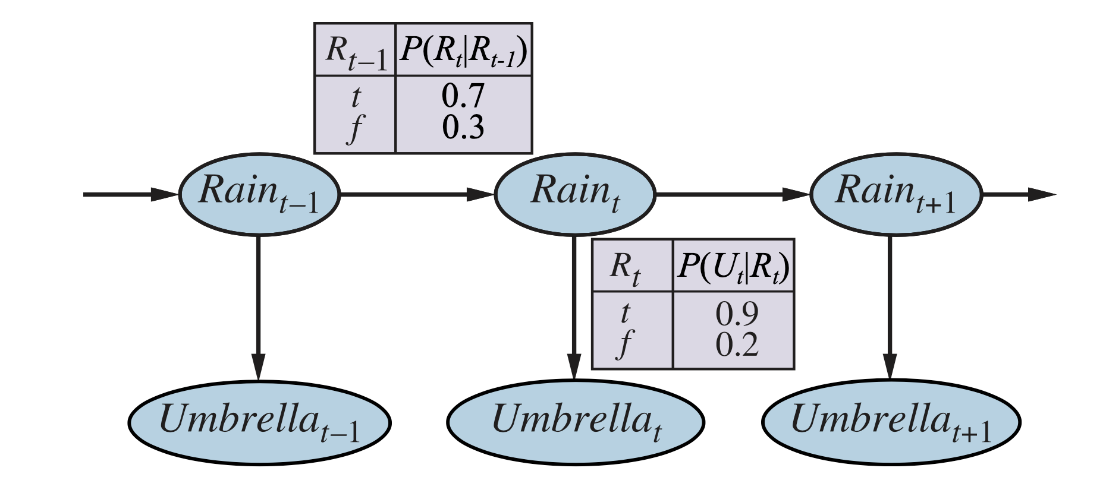
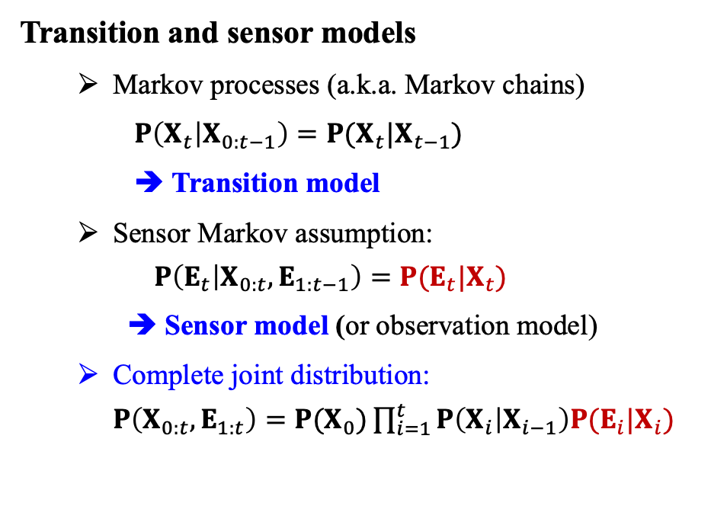
Temporal Models
Transition and sensor models
Markov processes (a.k.a. Markov chains)
$P\left(X_{t} | X_{0:t−1}\right)=P(X_{t}|X_{t−1})$
➔ Transition model
Sensor Markov assumption: $P\left(E_{t} | X_{0:t},E_{1:t−1}\right)=P(E_{t}|X_{t})$
➔ Sensor model (or observation model)
Complete joint distribution: $P\left(X_{0:t},E_{1:t}\right)=P(X_{0})\prod_{i=1}^{t}{P\left(X_{i} | X_{i−1}\right)P(E_{i}|X_{i})}$
<출처> Stuart J. Russell and Peter Norvig (2021). Artificial Intelligence: A Modern Approach (4th Edition). Pearson

Slide 6
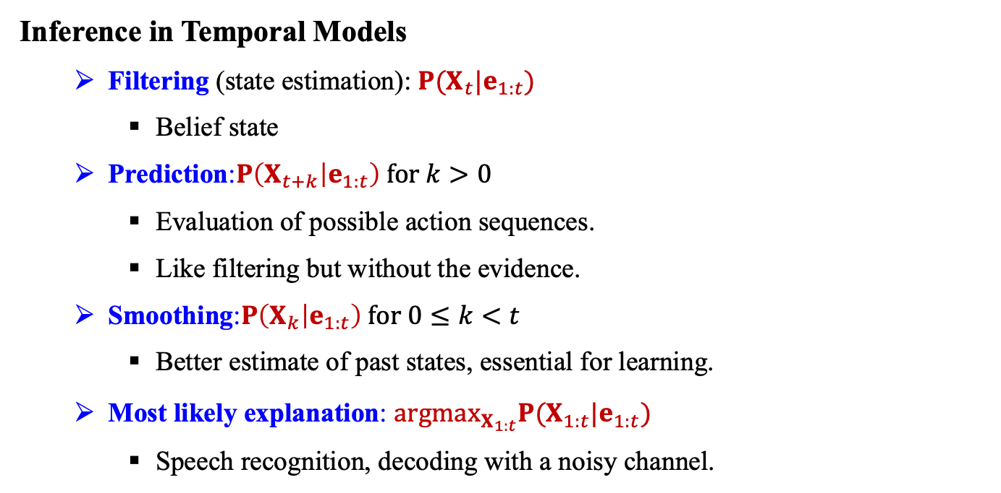
Inference in Temporal Models
Inference in Temporal Models
Filtering (state estimation): $P(X_{t}|e_{1:t})$
Belief state
Prediction:$P\left(X_{t+k} | e_{1:t}\right) for k>0$
Evaluation of possible action sequences.
Like filtering but without the evidence.
Smoothing:$P\left(X_{k} | e_{1:t}\right) for 0≤k<t$
Better estimate of past states, essential for learning.
Most likely explanation: ${argmax}_{X_{1:t}}P(X_{1:t}|e_{1:t})$
Speech recognition, decoding with a noisy channel.

Slide 7
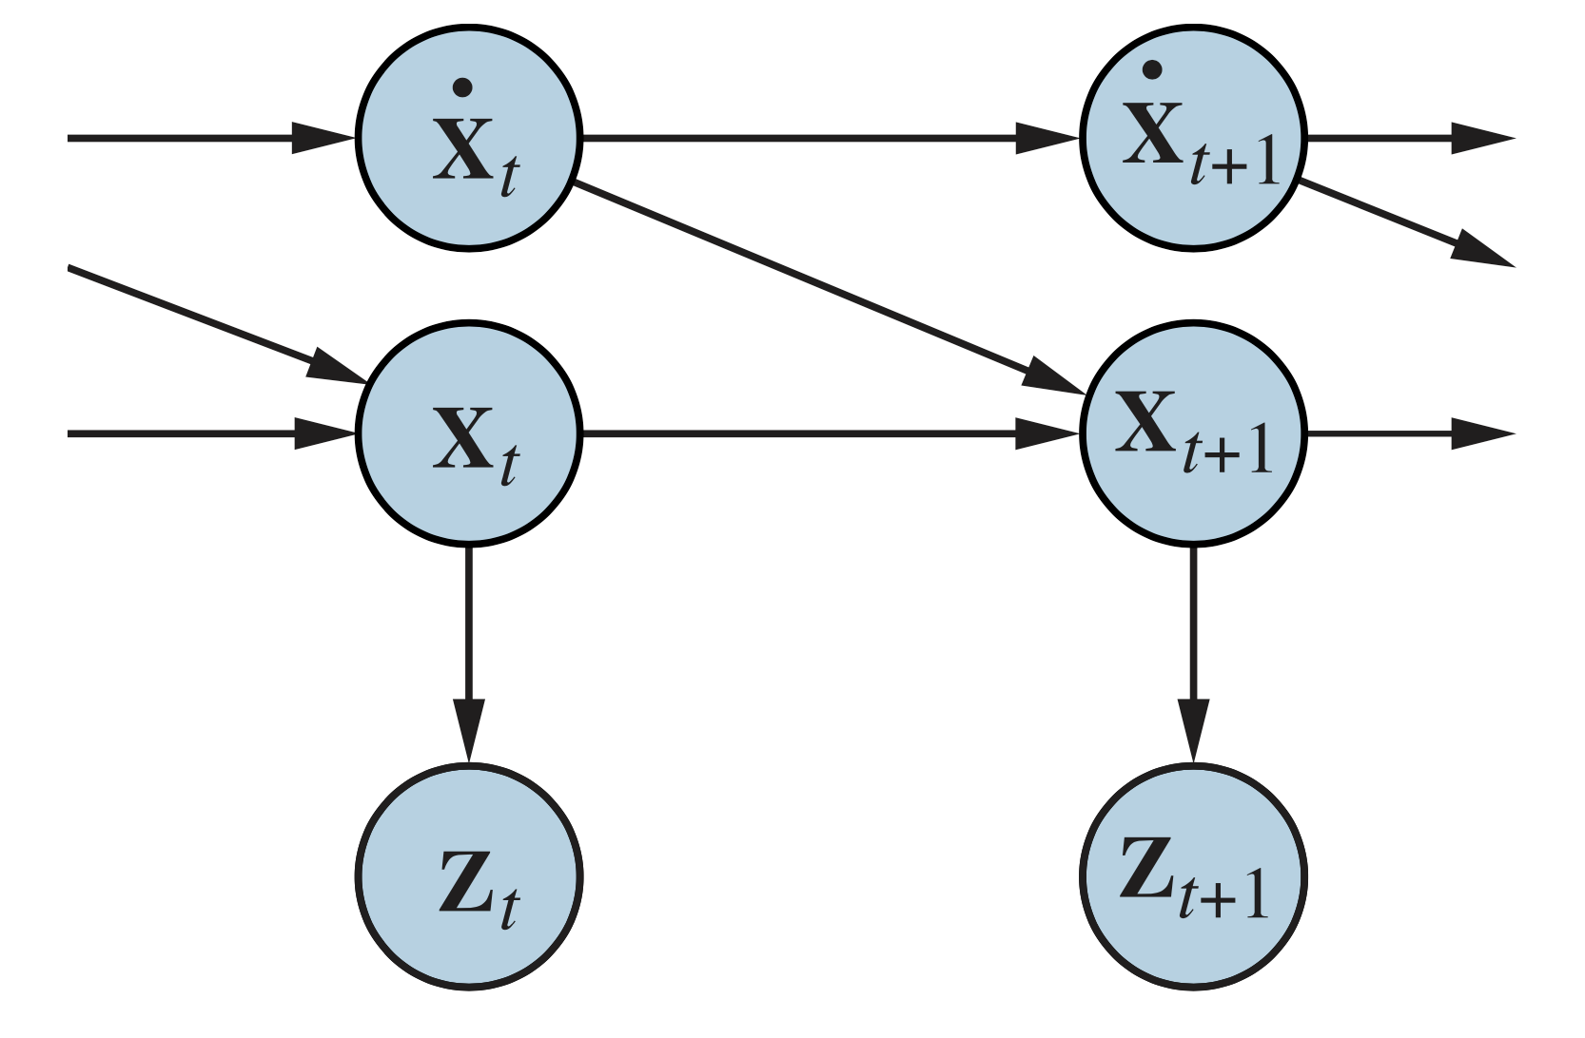
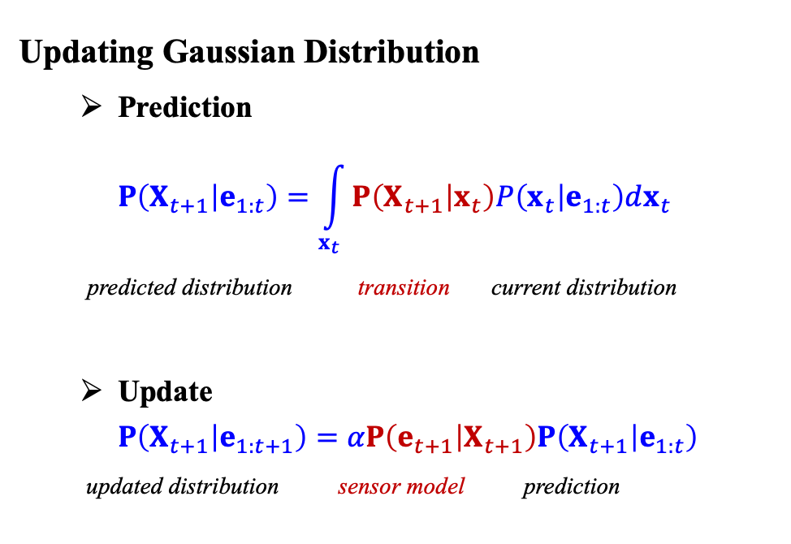
Kalman Filters
Updating Gaussian Distribution
Prediction $P\left(X_{t+1} | e_{1:t}\right)=\int_{x_{t}}^{ }{P\left(X_{t+1} | x_{t}\right)P\left(x_{t} | e_{1:t}\right)dx_{t}}$
predicted distribution transition current distribution
Update $P\left(X_{t+1} | e_{1:t+1}\right)=αP\left(e_{t+1} | X_{t+1}\right)P\left(X_{t+1} | e_{1:t}\right)$
updated distribution sensor model prediction
<출처> Stuart J. Russell and Peter Norvig (2021). Artificial Intelligence: A Modern Approach (4th Edition). Pearson

Slide 8
Lecture 12. Temporal Reasoning
How the agents interpret the present, understand the past, and predict the future, even when very little is clear. A changing world is modeled using a time variable. The transition and sensor models may be uncertain.
Inference tasks and inference algorithms for models with transition and sensor models:
Filtering
Prediction
Smoothing
Most likely sequence
Specific temporal probability models:
Hidden Markov Models
Kalman Filters
Dynamic Bayesian Networks
Particle Filters

Slide 9
Outline (Lecture 12)
12.1 Time and Uncertainty ………………...
12.2 Inference in Temporal Models …...…..
12.3 Hidden Markov Models …….….....….
12.4 Kalman filters …………………..……
12.5 Dynamic Bayesian Networks …….….
Summary ……………..…….............…......
9
14
22
26
31
39

Slide 10
12.1 Time and Uncertainty

Slide 11
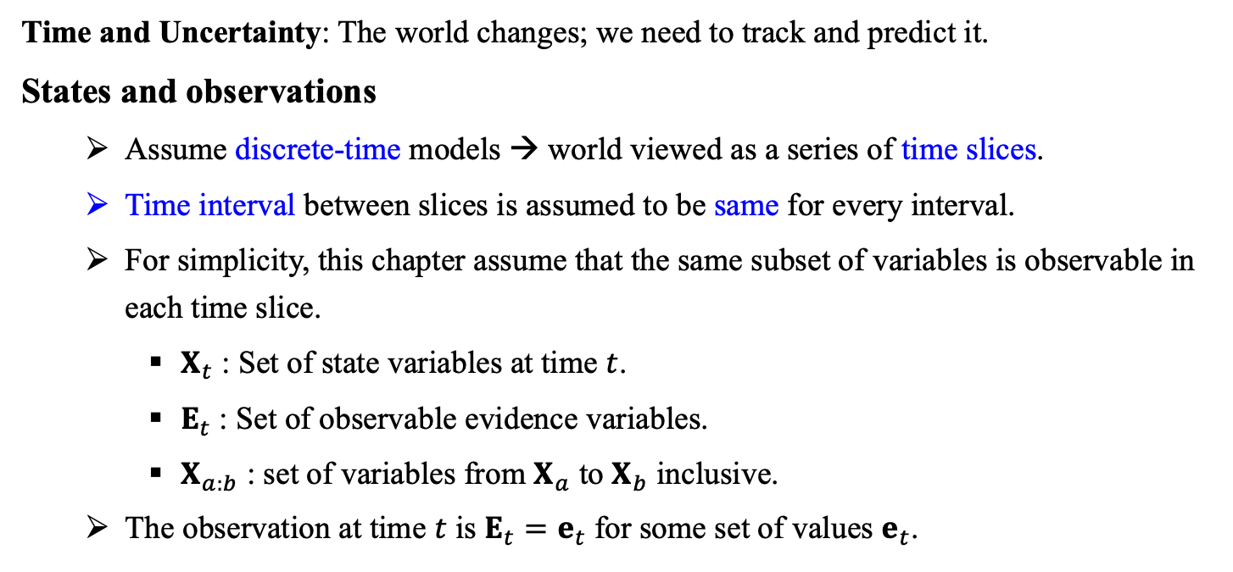
12.1 Time and Uncertainty (1/4)
Time and Uncertainty: The world changes; we need to track and predict it.
States and observations
Assume discrete-time models → world viewed as a series of time slices.
Time interval between slices is assumed to be same for every interval.
For simplicity, this chapter assume that the same subset of variables is observable in each time slice.
$X_{t}$ : Set of state variables at time $t$.
$E_{t}$ : Set of observable evidence variables.
$X_{a:b}$ : set of variables from $X_{a}$ to $X_{b}$ inclusive.
The observation at time $t$ is $E_{t}=e_{t}$ for some set of values $e_{t}$.

Slide 12
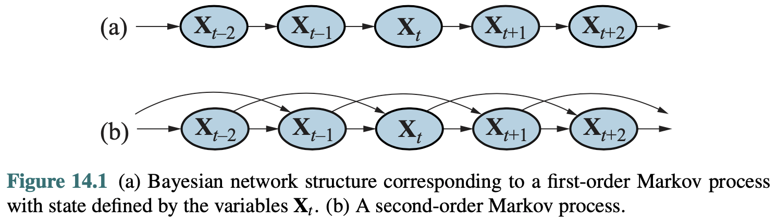
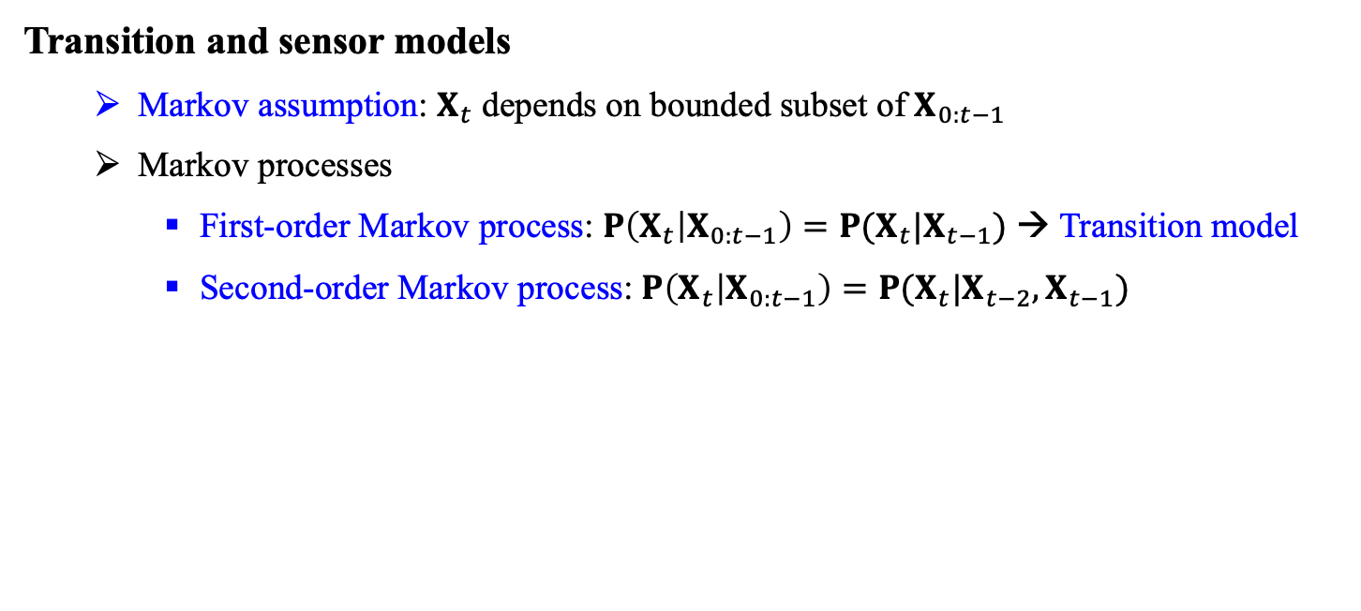
12.1 Time and Uncertainty (2/4)
Transition and sensor models
Markov assumption: $X_{t}$ depends on bounded subset of $X_{0:t−1}$
Markov processes
First-order Markov process: $P\left(X_{t} | X_{0:t−1}\right)=P(X_{t}|X_{t−1})$ → Transition model
Second-order Markov process: $P\left(X_{t} | X_{0:t−1}\right)=P(X_{t}|X_{t−2},X_{t−1})$
<출처> Stuart J. Russell and Peter Norvig (2021). Artificial Intelligence: A Modern Approach (4th Edition). Pearson

Slide 13
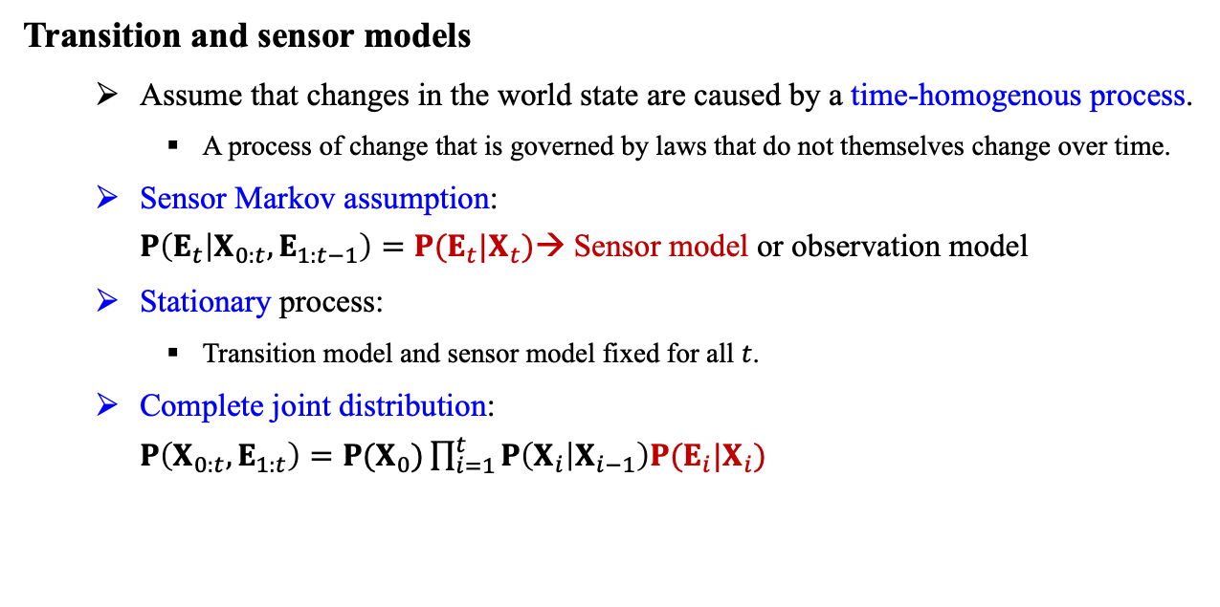
12.1 Time and Uncertainty (3/4)
Transition and sensor models
Assume that changes in the world state are caused by a time-homogenous process.
A process of change that is governed by laws that do not themselves change over time.
Sensor Markov assumption: $P\left(E_{t} | X_{0:t},E_{1:t−1}\right)=P(E_{t}|X_{t})$→ Sensor model or observation model
Stationary process:
Transition model and sensor model fixed for all $t$.
Complete joint distribution: $P\left(X_{0:t},E_{1:t}\right)=P(X_{0})\prod_{i=1}^{t}{P\left(X_{i} | X_{i−1}\right)P(E_{i}|X_{i})}$
<출처> Stuart J. Russell and Peter Norvig (2021). Artificial Intelligence: A Modern Approach (4th Edition). Pearson

Slide 14
12.1 Time and Uncertainty (4/4)
First-order Markov assumption not exactly true in the real world!
Possible fixes
Increase order of Markov process
Augment state (e.g. Temperature, Pressure, etc.)
Restore the Markov property by including charge level Battery.
Example: Robot motion
Augment position and velocity with Battery.

Slide 15
12.2 Inference in Temporal Models

Slide 16
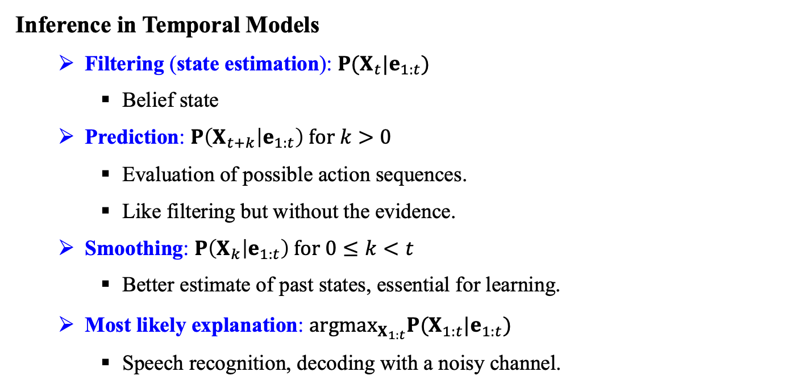
12.2 Inference in Temporal Models (1/7)
Inference in Temporal Models
Filtering (state estimation): $P(X_{t}|e_{1:t})$
Belief state
Prediction: $P\left(X_{t+k} | e_{1:t}\right) for k>0$
Evaluation of possible action sequences.
Like filtering but without the evidence.
Smoothing: $P\left(X_{k} | e_{1:t}\right) for 0≤k<t$
Better estimate of past states, essential for learning.
Most likely explanation: ${argmax}_{X_{1:t}}P(X_{1:t}|e_{1:t})$
Speech recognition, decoding with a noisy channel.

Slide 17
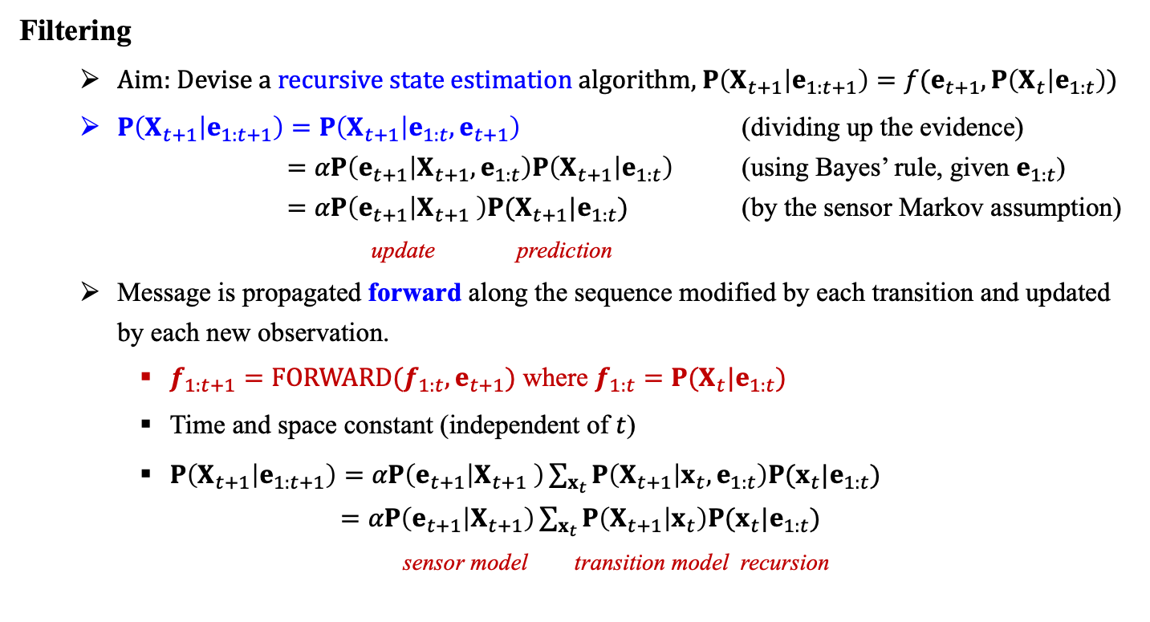
12.2 Inference in Temporal Models (2/7)
Filtering
Aim: Devise a recursive state estimation algorithm, $P\left(X_{t+1} | e_{1:t+1}\right)=f(e_{t+1},P\left(X_{t} | e_{1:t}\right))$
$P\left(X_{t+1} | e_{1:t+1}\right)=P\left(X_{t+1} | e_{1:t},e_{t+1}\right)$ (dividing up the evidence) $=αP\left(e_{t+1} | X_{t+1},e_{1:t}\right)P\left(X_{t+1} | e_{1:t}\right)$ (using Bayes’ rule, given $e_{1:t}$) $=αP\left(e_{t+1} | X_{t+1} \right)P(X_{t+1}|e_{1:t})$ (by the sensor Markov assumption)
update prediction
Message is propagated forward along the sequence modified by each transition and updated by each new observation.
$f_{1:t+1}=FORWARD(f_{1:t},e_{t+1})$ where $f_{1:t}=P(X_{t}|e_{1:t})$
Time and space constant (independent of $t$)
$P\left(X_{t+1} | e_{1:t+1}\right)=αP\left(e_{t+1} | X_{t+1} \right)\sum_{x_{t}}{P\left(X_{t+1} | x_{t},e_{1:t}\right)P(x_{t}|e_{1:t})}$ $=αP\left(e_{t+1} | X_{t+1}\right)\sum_{x_{t}}{P\left(X_{t+1} | x_{t}\right)P(x_{t}|e_{1:t})}$
sensor model transition model recursion

Slide 18
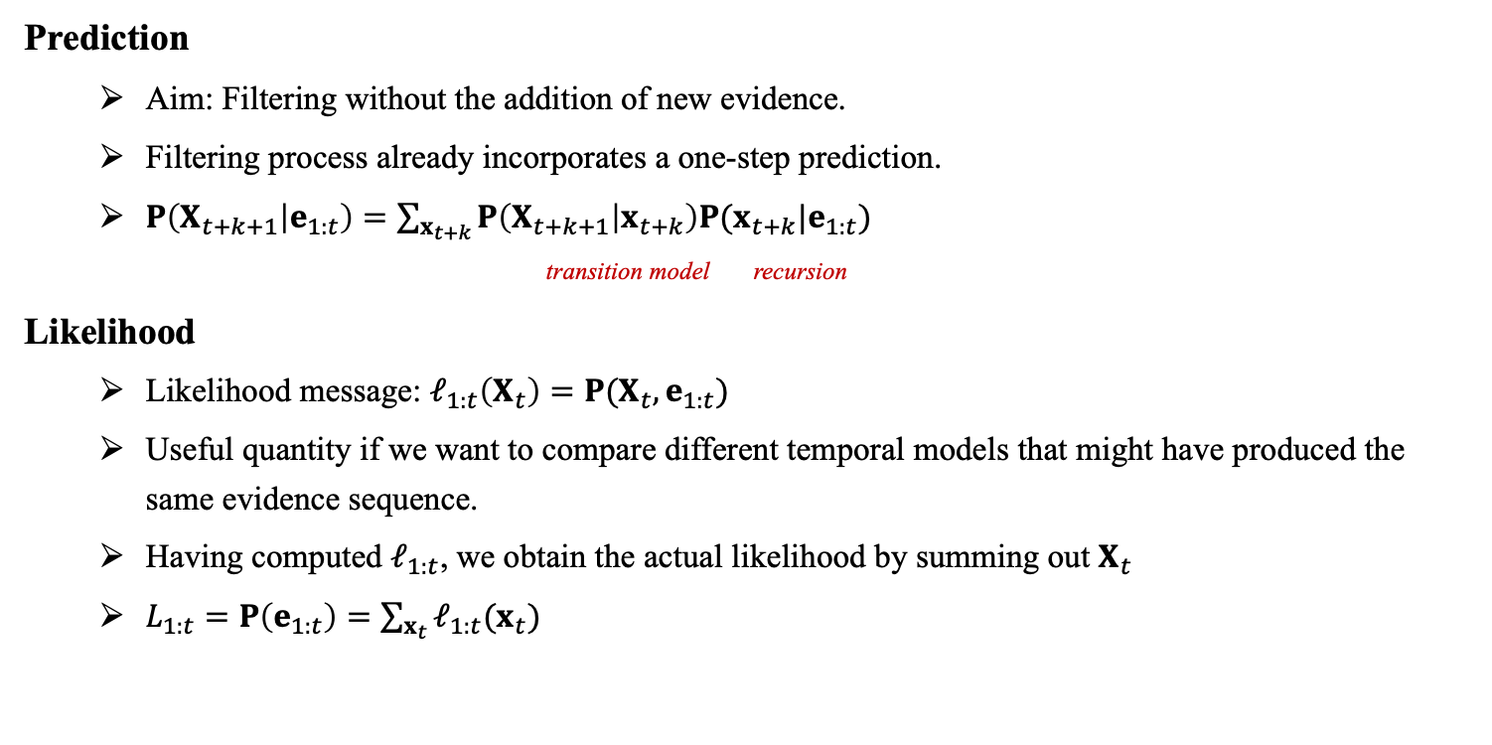
12.2 Inference in Temporal Models (3/7)
Prediction
Aim: Filtering without the addition of new evidence.
Filtering process already incorporates a one-step prediction.
$P\left(X_{t+k+1} | e_{1:t}\right)=\sum_{x_{t+k}}{P\left(X_{t+k+1} | x_{t+k}\right)P(x_{t+k}|e_{1:t})}$ transition model recursion
Likelihood
Likelihood message: $ℓ_{1:t}\left(X_{t}\right)=P(X_{t},e_{1:t})$
Useful quantity if we want to compare different temporal models that might have produced the same evidence sequence.
Having computed $ℓ_{1:t}$, we obtain the actual likelihood by summing out $X_{t}$
$L_{1:t}=P\left(e_{1:t}\right)=\sum_{x_{t}}{ℓ_{1:t}(x_{t})}$

Slide 19
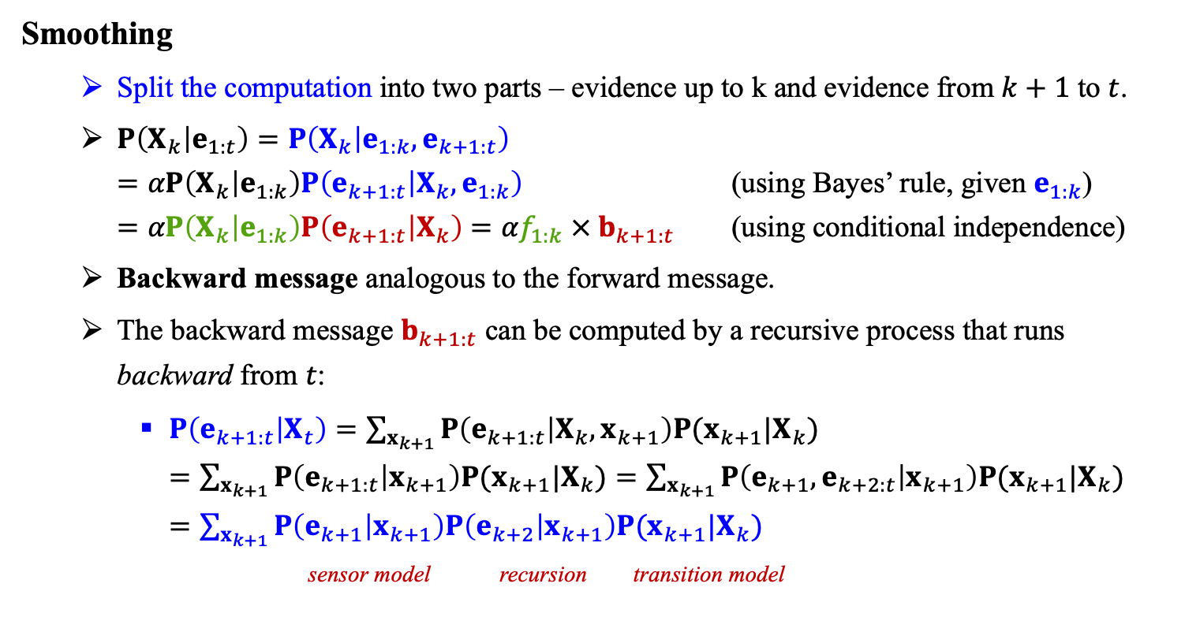
12.2 Inference in Temporal Models (4/7)
Smoothing
Split the computation into two parts – evidence up to k and evidence from $k+1$ to $t$.
$P\left(X_{k} | e_{1:t}\right)=P\left(X_{k} | e_{1:k},e_{k+1:t}\right)$ $=αP\left(X_{k} | e_{1:k}\right)P\left(e_{k+1:t} | X_{k},e_{1:k}\right)$ (using Bayes’ rule, given $e_{1:k}$) $=αP\left(X_{k} | e_{1:k}\right)P\left(e_{k+1:t} | X_{k}\right)$ $=αf_{1:k} × b_{k+1:t}$ (using conditional independence)
Backward message analogous to the forward message.
The backward message $b_{k+1:t}$ can be computed by a recursive process that runs backward from $t$:
$P\left(e_{k+1:t} | X_{t}\right)=\sum_{x_{k+1}}{P\left(e_{k+1:t} | X_{k},x_{k+1}\right)P(x_{k+1}|X_{k})}$ $=\sum_{x_{k+1}}{P\left(e_{k+1:t} | x_{k+1}\right)P(x_{k+1}|X_{k})}=\sum_{x_{k+1}}{P\left(e_{k+1},e_{k+2:t} | x_{k+1}\right)P(x_{k+1}|X_{k})}$ $=\sum_{x_{k+1}}{P\left(e_{k+1} | x_{k+1}\right)P\left(e_{k+2} | x_{k+1}\right)P(x_{k+1}|X_{k})}$ sensor model recursion transition model

Slide 20
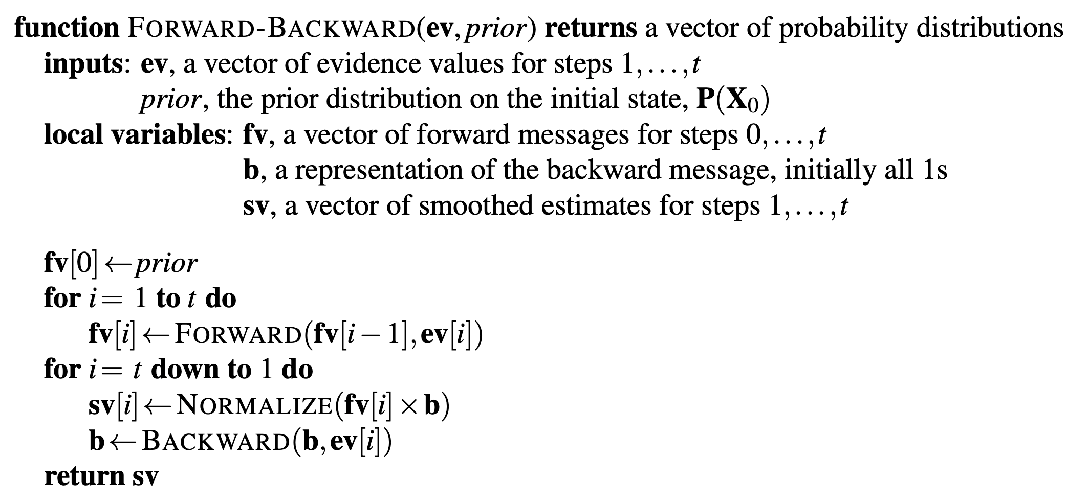
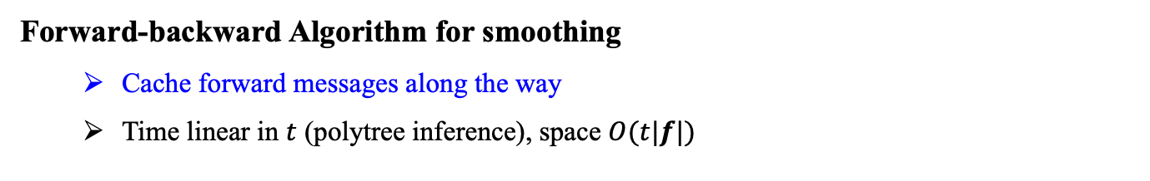
12.2 Inference in Temporal Models (5/7)
Forward-backward Algorithm for smoothing
Cache forward messages along the way
Time linear in $t$ (polytree inference), space $O(t|f|)$
<출처> Stuart J. Russell and Peter Norvig (2021). Artificial Intelligence: A Modern Approach (4th Edition). Pearson

Slide 21
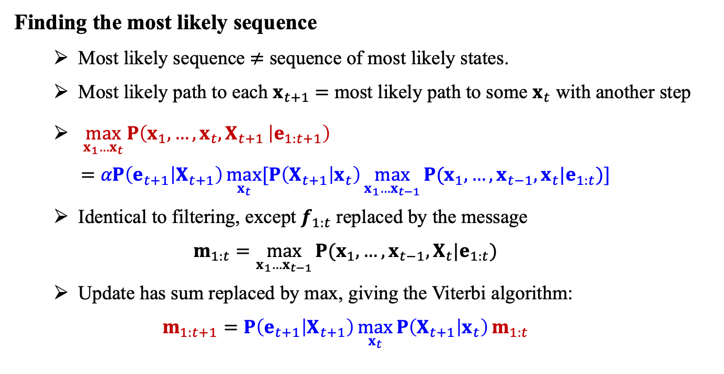
12.2 Inference in Temporal Models (6/7)
Finding the most likely sequence
Most likely sequence $≠$ sequence of most likely states.
Most likely path to each $x_{t+1}$ $=$ most likely path to some $x_{t}$ with another step
$\max_{x_{1}…x_{t}}{P\left(x_{1},…,x_{t}, X_{t+1 } | e_{1:t+1}\right)}$ $=αP\left(e_{t+1} | X_{t+1}\right)\max_{x_{t}}{[P\left(X_{t+1} | x_{t}\right)\max_{x_{1}…x_{t−1}}{P(x_{1},…,x_{t−1}, x_{t}|e_{1:t})}]}$
Identical to filtering, except $f_{1:t}$ replaced by the message $m_{1:t}=\max_{x_{1}…x_{t−1}}{P(x_{1},…,x_{t−1}, X_{t}|e_{1:t})}$
Update has sum replaced by max, giving the Viterbi algorithm: $m_{1:t+1}=P\left(e_{t+1} | X_{t+1}\right)\max_{x_{t}}{P\left(X_{t+1} | x_{t}\right)}m_{1:t}$

Slide 22
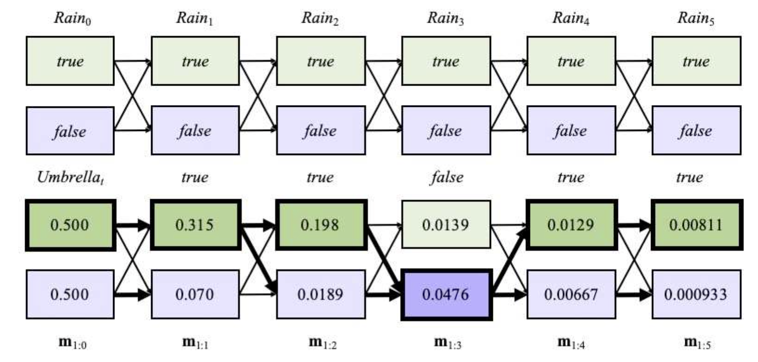
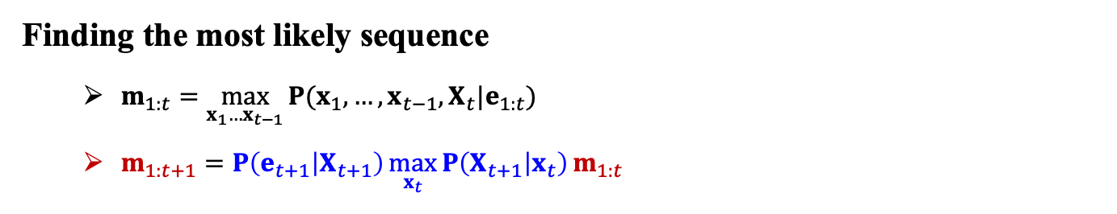
12.2 Inference in Temporal Models (7/7)
Finding the most likely sequence
$m_{1:t}=\max_{x_{1}…x_{t−1}}{P(x_{1},…,x_{t−1}, X_{t}|e_{1:t})}$
$m_{1:t+1}=P\left(e_{t+1} | X_{t+1}\right)\max_{x_{t}}{P\left(X_{t+1} | x_{t}\right)}m_{1:t}$
Operation of the Viterbi algorithm for the umbrella observation sequence.
[true,true,false,true,true]
<출처> Stuart J. Russell and Peter Norvig (2021). Artificial Intelligence: A Modern Approach (4th Edition). Pearson

Slide 23
12.3 Hidden Markov Models

Slide 24
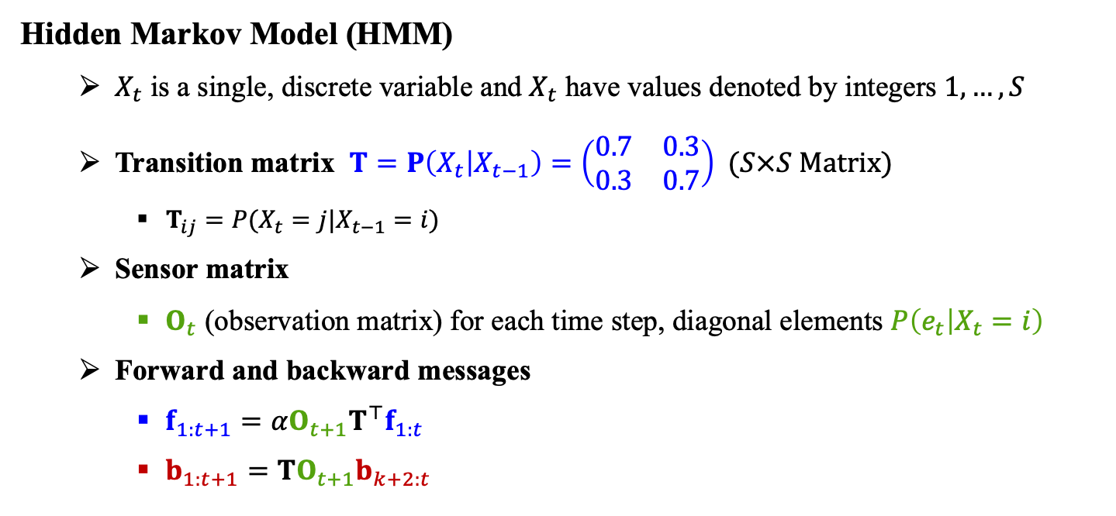
12.3 Hidden Markov Models (1/3)
Hidden Markov Model (HMM)
$X_{t}$ is a single, discrete variable and $X_{t}$ have values denoted by integers $1,…,S$
Transition matrix $T=P\left(X_{t} | X_{t−1}\right)=\left(\begin{matrix}0.7 & 0.3 \\ 0.3 & 0.7\end{matrix}\right)$ ($S×S$ Matrix)
$T_{ij}=P(X_{t}=j|X_{t−1}=i)$
Sensor matrix
$O_{t}$ (observation matrix) for each time step, diagonal elements $P\left(e_{t} | X_{t}=i\right)$
Forward and backward messages
$f_{1:t+1}=αO_{t+1}T^{⊤}f_{1:t}$
$b_{1:t+1}=TO_{t+1}b_{k+2:t}$

Slide 25
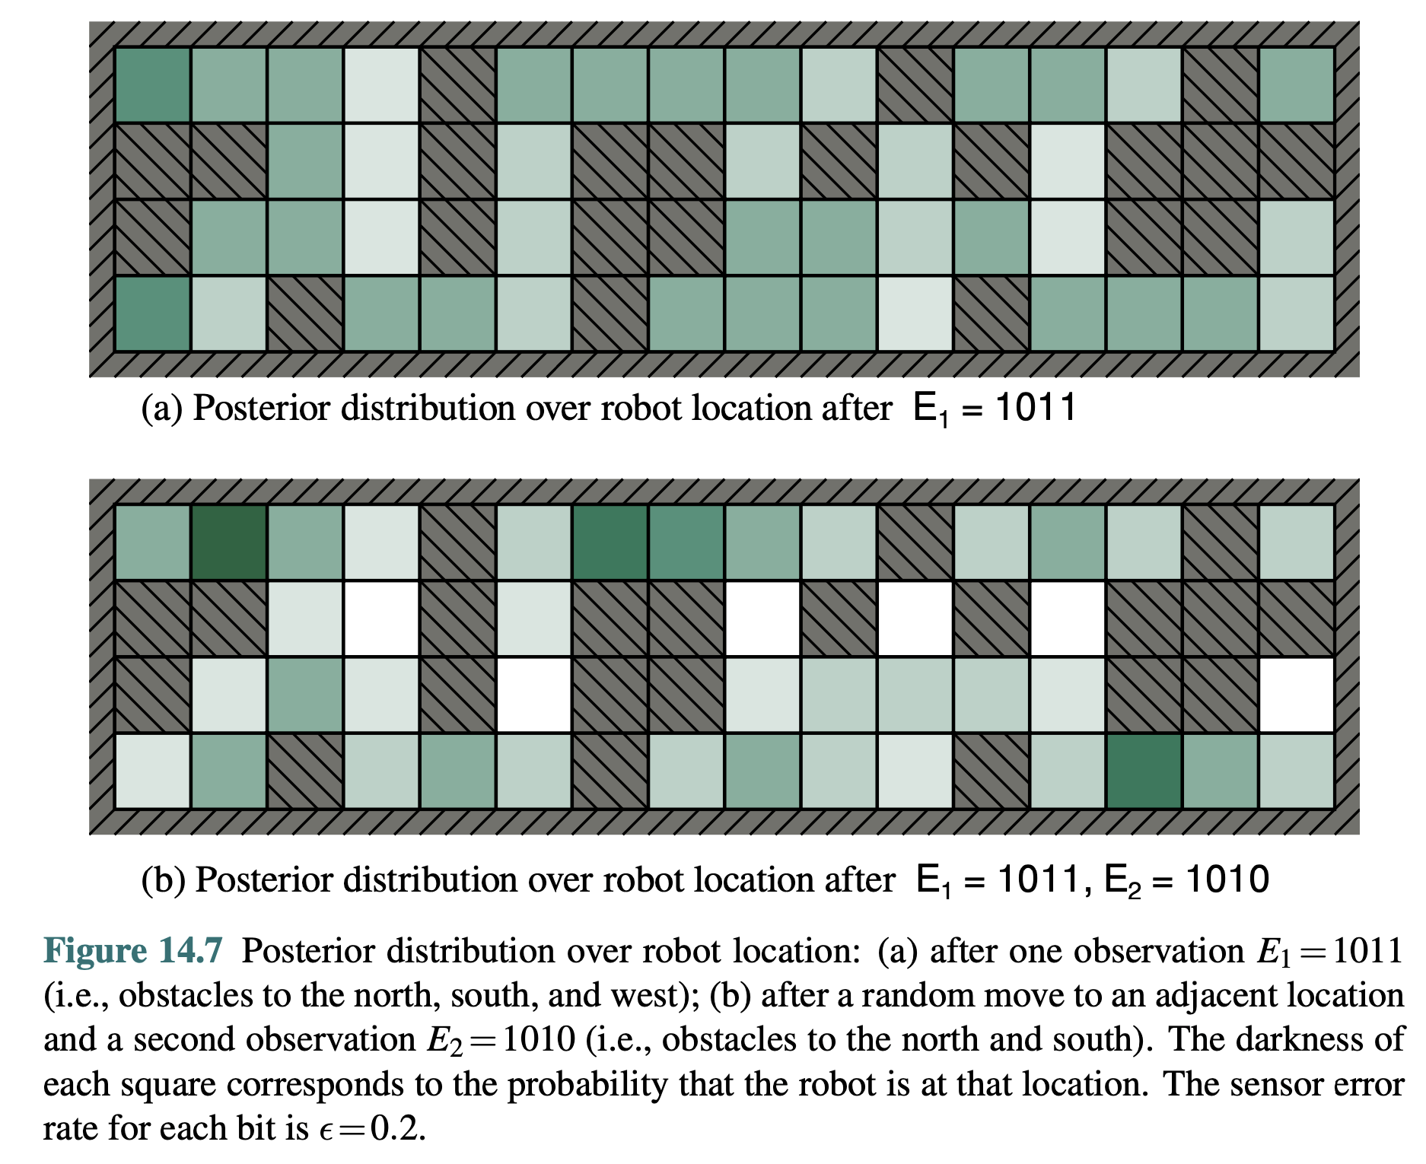
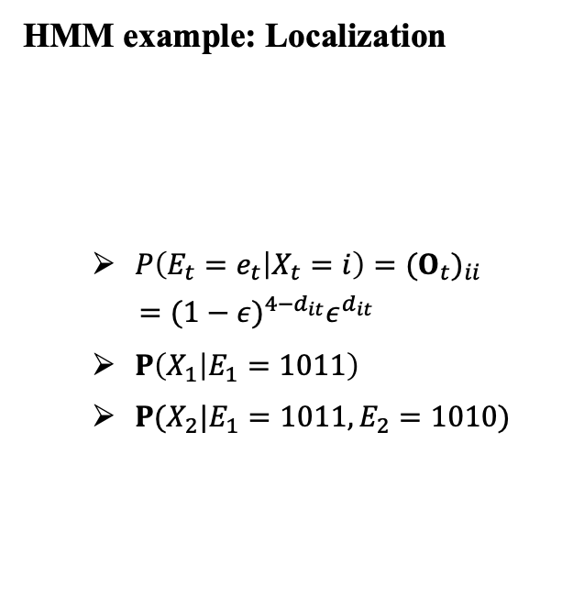
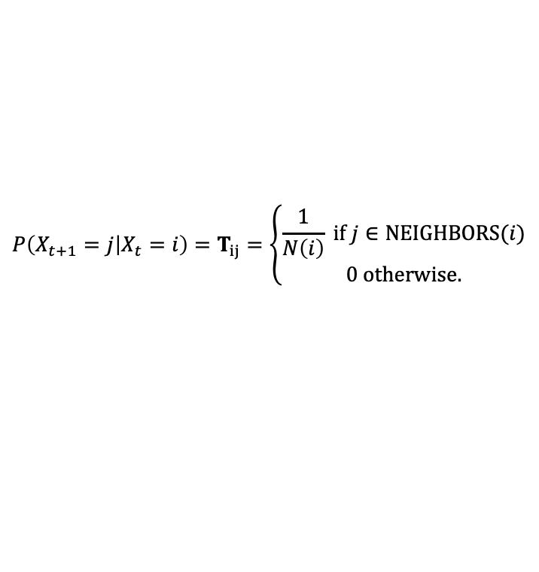
12.3 Hidden Markov Models (2/3)
HMM example: Localization
$P\left(E_{t}=e_{t} | X_{t}=i\right)={(O_{t})}_{ii}$
$$={(1−ε)}^{4−d_{it}}ε^{d_{it}}$$
$P\left(X_{1} | E_{1}=1011\right)$
$P(X_{2}|E_{1}=1011,E_{2}=1010)$
$$P\left(X_{t+1}=j | X_{t}=i\right)=T_{ij}=\left\{\begin{aligned}\frac{1}{N\left(i\right)} if j∈NEIGHBORS(i) \\ 0 otherwise.\end{aligned}\right.$$
<출처> Stuart J. Russell and Peter Norvig (2021). Artificial Intelligence: A Modern Approach (4th Edition). Pearson

Slide 26
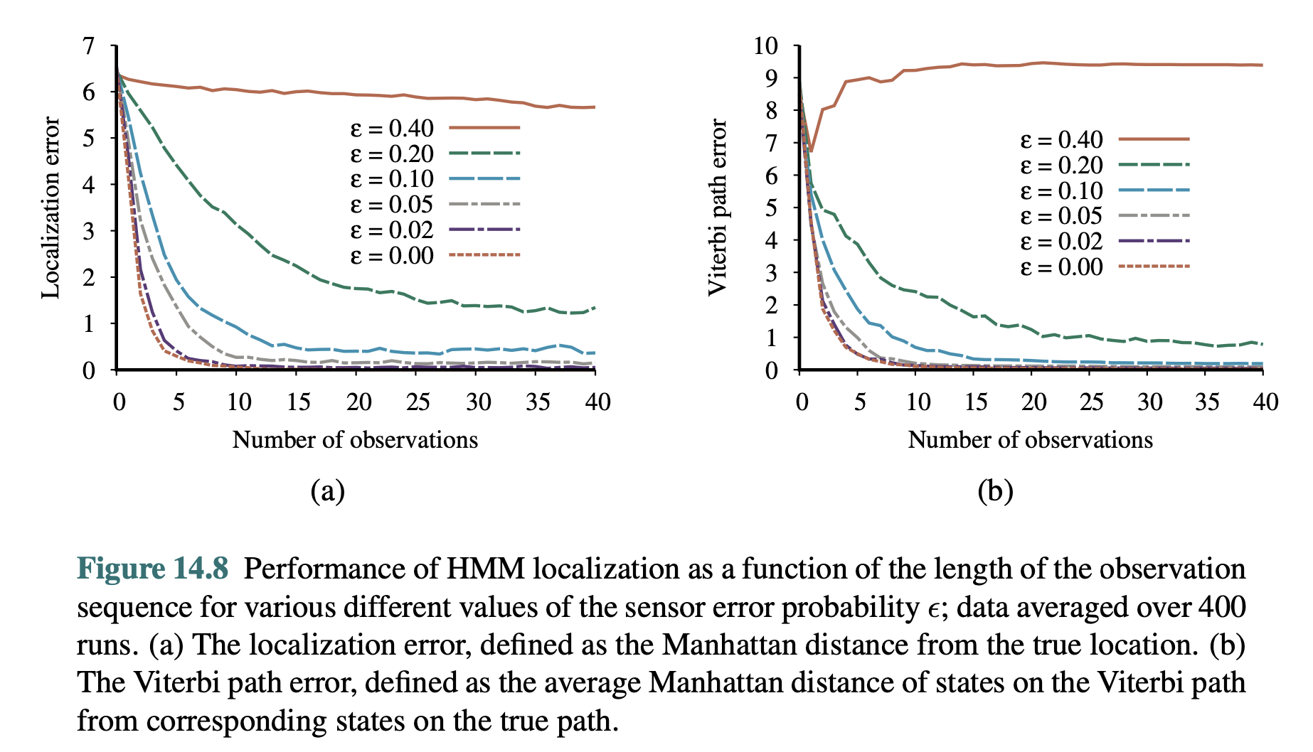
12.3 Hidden Markov Models (3/3)
Performance of HMM Localization
<출처> Stuart J. Russell and Peter Norvig (2021). Artificial Intelligence: A Modern Approach (4th Edition). Pearson

Slide 27
12.4 Kalman Filters

Slide 28
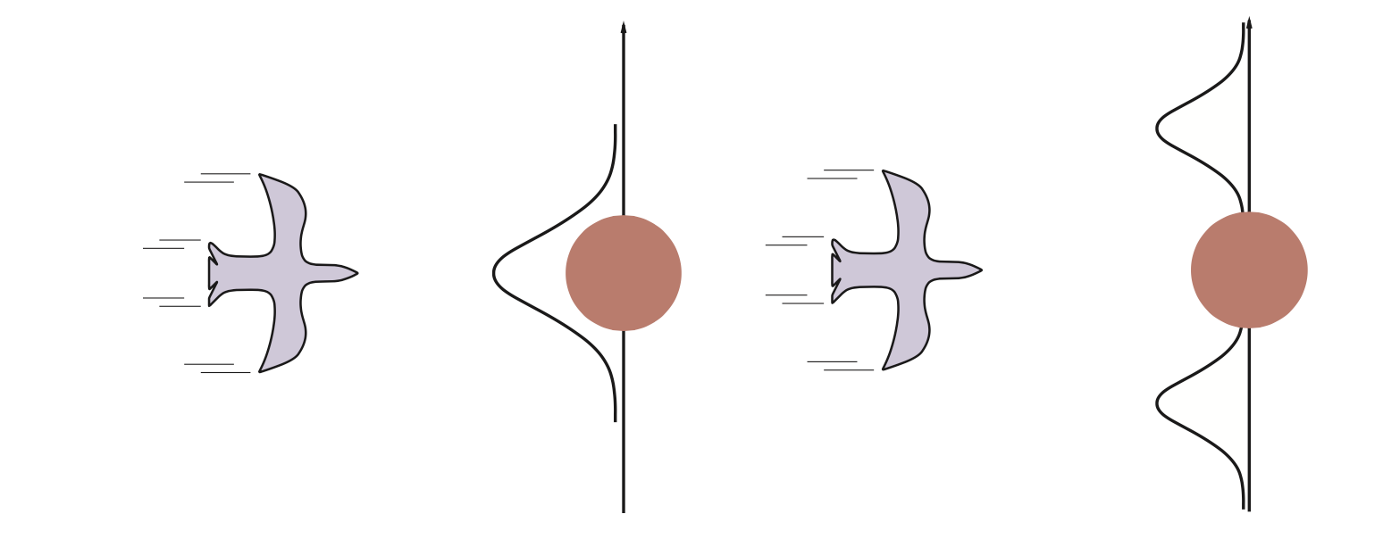
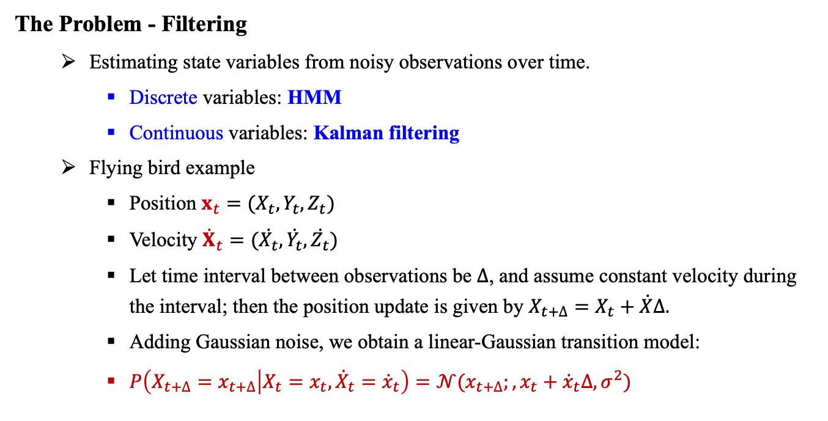
12.4 Kalman Filters (1/4)
The Problem - Filtering
Estimating state variables from noisy observations over time.
Discrete variables: HMM
Continuous variables: Kalman filtering
Flying bird example
Position $x_{t}=(X_{t},Y_{t},Z_{t})$
Velocity ${\dot{X}}_{t}=(\dot{X_{t}},\dot{Y_{t}},\dot{Z_{t}})$
Let time interval between observations be $∆$, and assume constant velocity during the interval; then the position update is given by $X_{t+∆}=X_{t}+\dot{X}∆.$
Adding Gaussian noise, we obtain a linear-Gaussian transition model:
$P\left(X_{t+∆}=x_{t+∆} | X_{t}=x_{t},{\dot{X}}_{t}={\dot{x}}_{t}\right)=𝒩(x_{t+∆};,x_{t}+{\dot{x}}_{t}∆,σ^{2})$
<출처> Stuart J. Russell and Peter Norvig (2021). Artificial Intelligence: A Modern Approach (4th Edition). Pearson

Slide 29
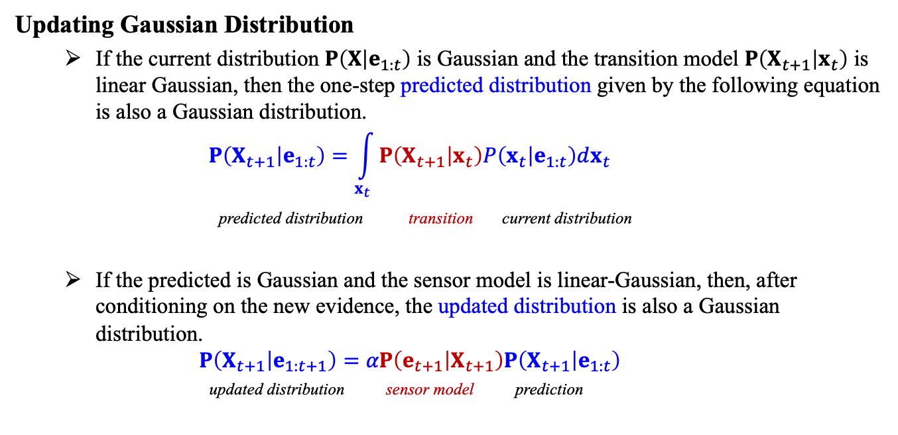
12.4 Kalman Filters (2/4)
Updating Gaussian Distribution
If the current distribution $P\left(X | e_{1:t}\right)$ is Gaussian and the transition model $P\left(X_{t+1} | x_{t}\right)$ is linear Gaussian, then the one-step predicted distribution given by the following equation is also a Gaussian distribution. $P\left(X_{t+1} | e_{1:t}\right)=\int_{x_{t}}^{ }{P\left(X_{t+1} | x_{t}\right)P\left(x_{t} | e_{1:t}\right)dx_{t}}$
predicted distribution transition current distribution
If the predicted is Gaussian and the sensor model is linear-Gaussian, then, after conditioning on the new evidence, the updated distribution is also a Gaussian distribution. $P\left(X_{t+1} | e_{1:t+1}\right)=αP\left(e_{t+1} | X_{t+1}\right)P\left(X_{t+1} | e_{1:t}\right)$
updated distribution sensor model prediction
<출처> Stuart J. Russell and Peter Norvig (2021). Artificial Intelligence: A Modern Approach (4th Edition). Pearson

Slide 30
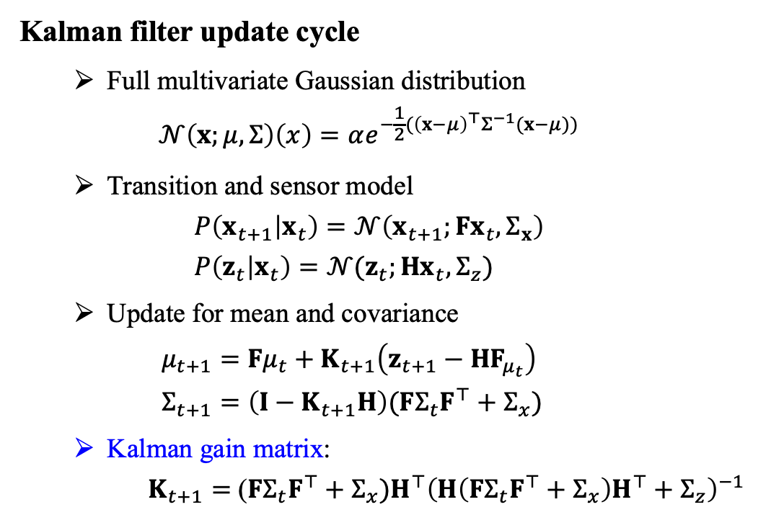
12.4 Kalman Filters (3/4)
Kalman filter update cycle
Full multivariate Gaussian distribution $𝒩\left(x;μ,Σ\right)\left(x\right)=αe^{−\frac{1}{2}({\left(x−μ\right)}^{⊤}Σ^{−1}(x−μ))}$
Transition and sensor model $P\left(x_{t+1} | x_{t}\right)=𝒩\left(x_{t+1};Fx_{t},Σ_{x}\right)$ $P\left(z_{t} | x_{t}\right)=𝒩(z_{t};Hx_{t},Σ_{z})$
Update for mean and covariance $μ_{t+1}=Fμ_{t}+K_{t+1}\left(z_{t+1}−HF_{μ_{t}}\right)$ $Σ_{t+1}=\left(I−K_{t+1}H\right)(FΣ_{t}F^{⊤}+Σ_{x})$
Kalman gain matrix: $K_{t+1}=$ ($FΣ_{t}F^{⊤}+Σ_{x})H^{⊤}{\left(H\left(FΣ_{t}F^{⊤}+Σ_{x}\right)H^{⊤}+Σ_{z}\right)}^{−1}$
<출처> Stuart J. Russell and Peter Norvig (2021). Artificial Intelligence: A Modern Approach (4th Edition). Pearson

Slide 31
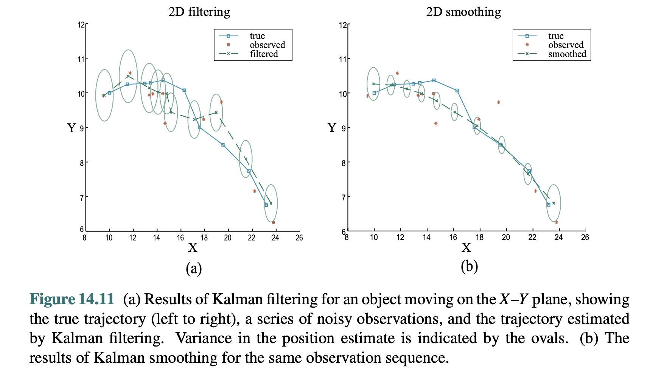
12.4 Kalman Filters (4/4)
Result of Kalman filtering for an object moving on the X-Y plane
<출처> Stuart J. Russell and Peter Norvig (2021). Artificial Intelligence: A Modern Approach (4th Edition). Pearson

Slide 32
12.5 Dynamic Bayesian Networks

Slide 33
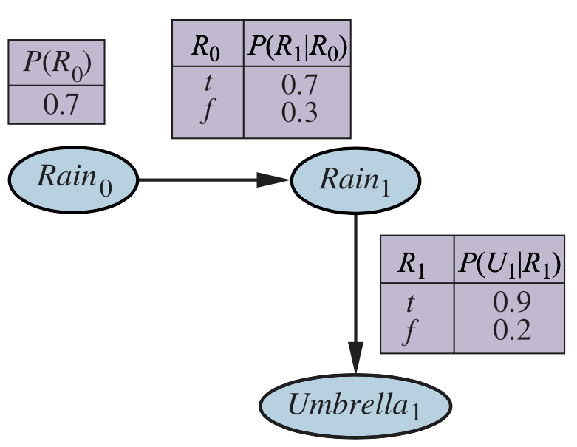
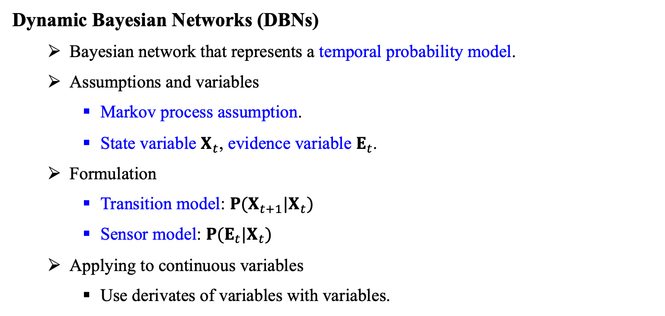
12.5 Dynamic Bayesian Networks (1/7)
Dynamic Bayesian Networks (DBNs)
Bayesian network that represents a temporal probability model.
Assumptions and variables
Markov process assumption.
State variable $X_{t}$, evidence variable $E_{t}$.
Formulation
Transition model: $P(X_{t+1}|X_{t})$
Sensor model: $P(E_{t}|X_{t})$
Applying to continuous variables
Use derivates of variables with variables.
<출처> Stuart J. Russell and Peter Norvig (2021). Artificial Intelligence: A Modern Approach (4th Edition). Pearson

Slide 34
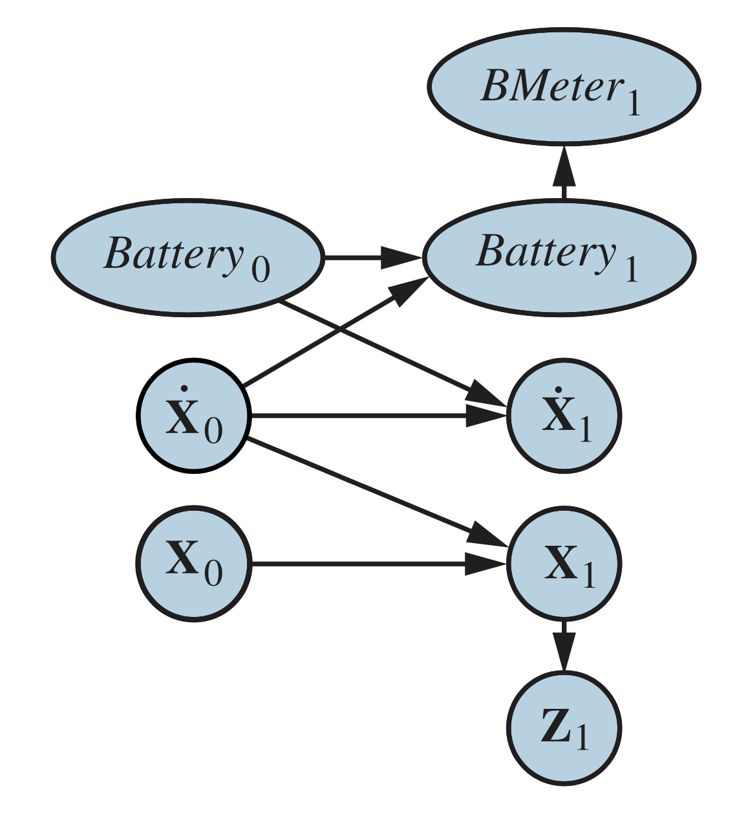
12.5 Dynamic Bayesian Networks (2/7)
Dynamic Bayesian Network for robot motion in X-Y plane
<출처> Stuart J. Russell and Peter Norvig (2021). Artificial Intelligence: A Modern Approach (4th Edition). Pearson

Slide 35
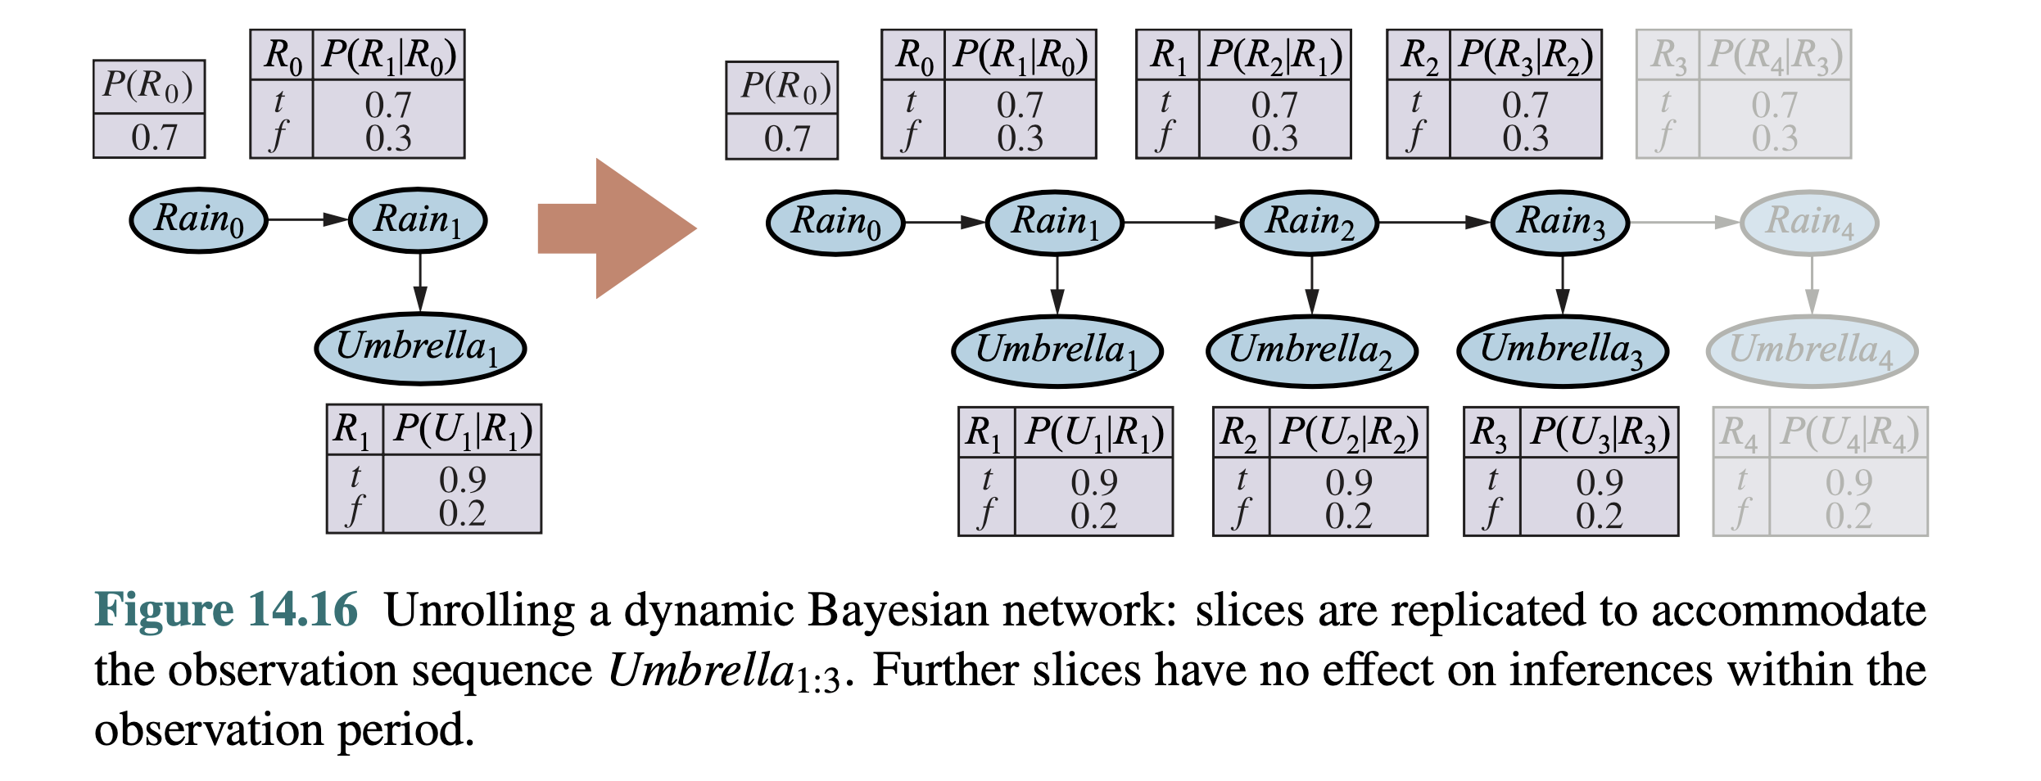
12.5 Dynamic Bayesian Networks (3/7)
Unrolling a Dynamic Bayesian Network
Unrolling: Transition and sensor models shared, so we can repeat recursively. Slices are replicated to accommodate the observation sequence.
Once unrolled, exact inferences for Bayesian networks can be used.
<출처> Stuart J. Russell and Peter Norvig (2021). Artificial Intelligence: A Modern Approach (4th Edition). Pearson

Slide 36
12.5 Dynamic Bayesian Networks (4/7)
Appropriate inference in DBNs (by Particle Filtering)
MCMC, Likelihood weighting
Particle Filtering (a.k.a. Sequential importance sampling with resampling)
Use the samples themselves as an approximate representation of the current state distribution.
Focus the set of samples on the high-probability regions of the state space.

Slide 37
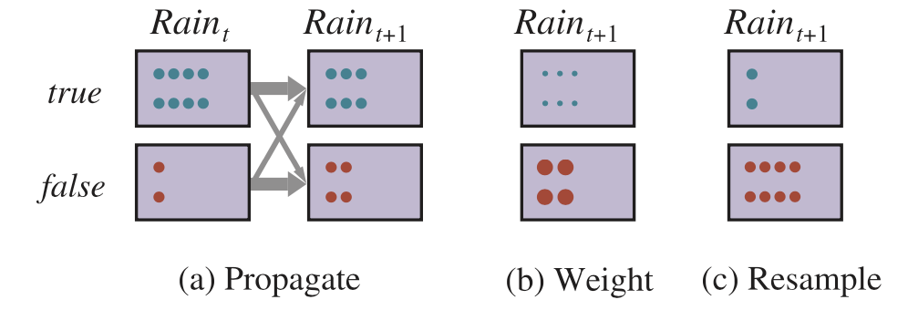
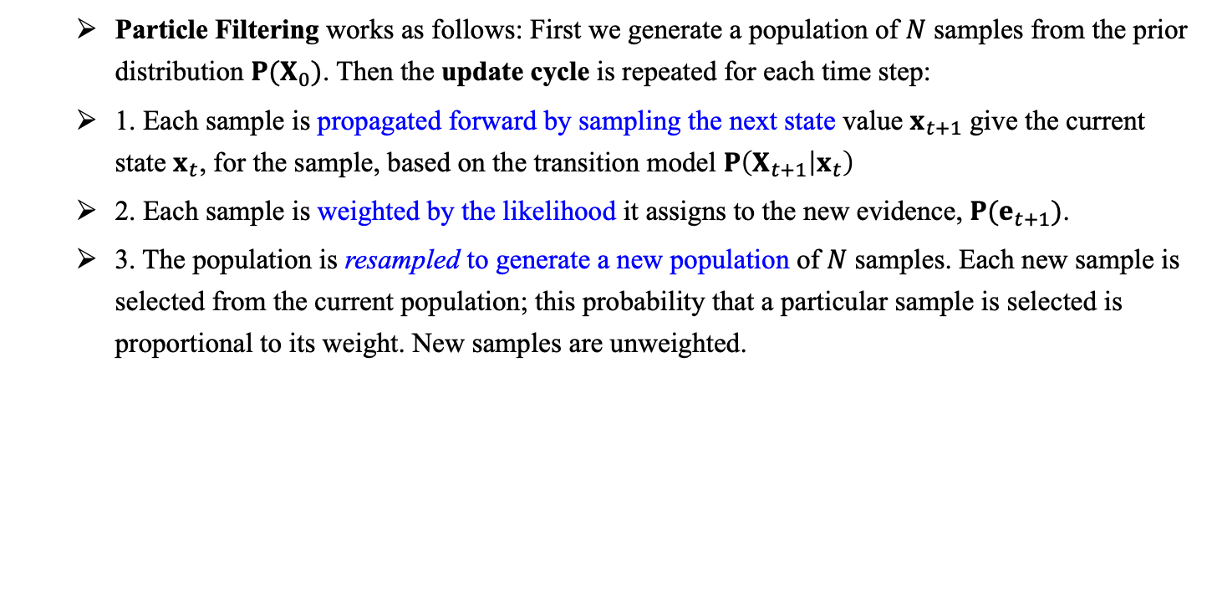
12.5 Dynamic Bayesian Networks (5/7)
Particle Filtering works as follows: First we generate a population of $N$ samples from the prior distribution $P(X_{0})$. Then the update cycle is repeated for each time step:
1. Each sample is propagated forward by sampling the next state value $x_{t+1}$ give the current state $x_{t}$, for the sample, based on the transition model $P\left(X_{t+1} | x_{t}\right)$
2. Each sample is weighted by the likelihood it assigns to the new evidence, $P(e_{t+1})$.
3. The population is resampled to generate a new population of $N$ samples. Each new sample is selected from the current population; this probability that a particular sample is selected is proportional to its weight. New samples are unweighted.
<출처> Stuart J. Russell and Peter Norvig (2021). Artificial Intelligence: A Modern Approach (4th Edition). Pearson

Slide 38
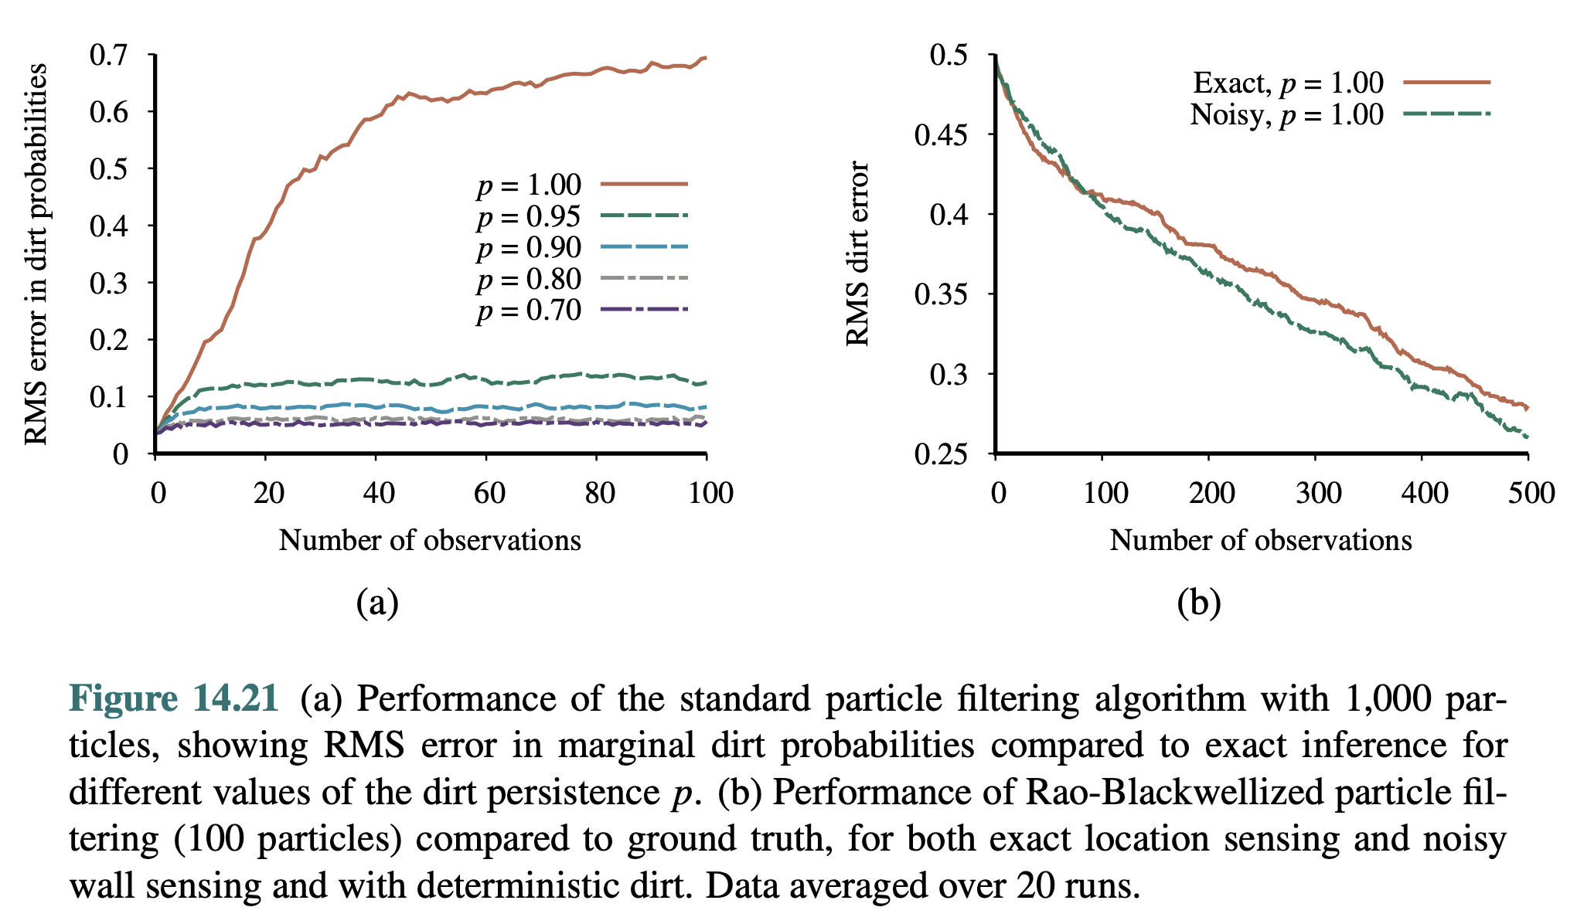
12.5 Dynamic Bayesian Networks (6/7)
Performance of the standard particle filtering algorithm
<출처> Stuart J. Russell and Peter Norvig (2021). Artificial Intelligence: A Modern Approach (4th Edition). Pearson

Slide 39
12.5 Dynamic Bayesian Networks (7/7)
Rao-Blackwellization
Based on the idea that exact inference is always more accurate than sampling.
For the SLAM problem, we run particle filtering on the robot location and then, for each particle, we run exact HMM inference for each dirt square independently, conditioned on the location sequence in that particle.

Slide 40
Summary
Representations can be designed to satisfy the Markov property, so that the future is independent of the past given the present. Combined with the assumption that the process is time-homogenous, this greatly simplifies the representation.
A temporal probability model contains a transition model describing the state evolution and a sensor model describing the observation process.
The principal inference tasks in temporal models are filtering (state estimation), prediction, smoothing, and computing the most likely explanation.
These families of temporal models were studied in more depth: Hidden Markov Models, Kalman Filters, and Dynamic Bayesian Networks.
Unless special assumptions are made, as in Kalman filters, exact inference with many state variables in intractable.
In practice, the particle filtering algorithm and its descendants are an effective family approximate algorithms.

